Slide 1
Priority Pass & Taxi App Integration C4 Diagrams

Slide 2
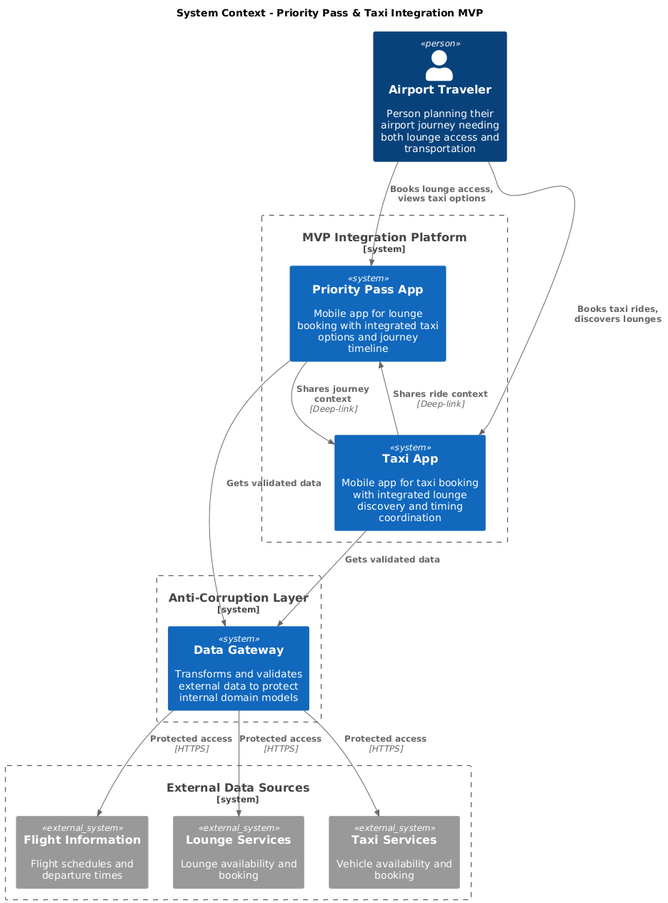

Slide 3
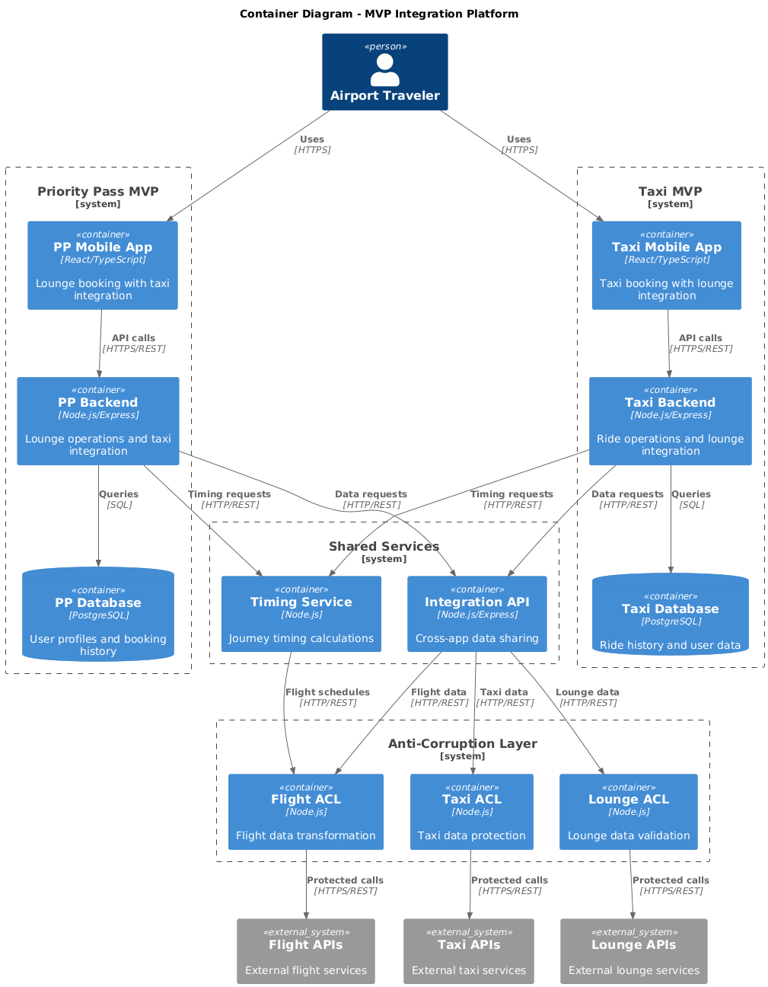

Slide 4
